Slide 1
CS152 Section 13
Final Exam Review (Part 1)

Slide 2
Administrivia
Final exam scheduled for Mon, May 10 (7pm-10pm PDT)
Lab 5 due Mon, May 3

Slide 3
Agenda
Final review!
Final exam is cumulative
Non-exhaustive checklist of concepts
Focus on post-MT2 material: cache coherence, memory consistency, synchronization
Another review session will be held during RRR week in the discussion section time slot
Focus on MT1 and MT2 material
Option to combine discussion sections for a longer review session

Slide 4
Thinking as a Computer Architect
Unifying themes and principles we hope you take away from CS152:
Focus on programming models
How best to map computation to different architectures
Parallelism = performance
Various ways to exploit parallelism: OoO, VLIW, vector, SIMD, SIMT, etc.
Pros and cons of each architecture (efficiency, flexibility, cost, etc.)
Can move complexity between hardware and software
Identify the common cases and patterns, and optimize for them
Locality
RISC
Notes:
Framing the course

Slide 5
Thinking as a Computer Architect
Understand the problem
What factors limit the performance of a machine
Motivations, challenges, and trade-offs in implementing a given feature
Cross-cutting issues: How feature X impacts the design of Y elsewhere
Correctness vs performance
Leverage reusable concepts in the architect’s toolbox
Pipelining, speculation, caches, hierarchies, etc.
Old ideas made new again in novel contexts
Build a balanced system
Amdahl's Law of diminishing returns
Not just about the processor alone

Slide 6
Preliminaries
Architecture vs microarchitecture
RISC vs CISC
Iron Law: analyzing trade-offs in the design space
Microcoding

Slide 7
Pipelining
Hazards: structural, data, control
Handling hazards with interlocks, bypassing, speculation, and software techniques
In-order pipelines: classic 5-stage to complex superscalar
Multiple and variable-latency functional units
Latency vs throughput
Exceptions
Implementing precise exceptions
Synchronous traps vs asynchronous interrupts

Slide 8
Memory Hierarchy
Temporal and spatial locality
3 4 C’s of cache misses: compulsory, capacity, conflict, coherence
Cache organization: associativity, replacement policy, write policy
Cache optimizations to reduce miss rate and miss penalty
Multi-level caches
Write buffers
Prefetching
Software optimizations: loop transformations, cache tiling

Slide 9
Address Translation and Protection
Paging vs segmentation
Virtual memory
Hierarchical page table walks
TLBs
Page faults, demand paging
Interaction with cache design: virtual address aliases

Slide 10
Out-of-Order Execution
InO/OoO stages: fetch, dispatch, rename, issue, completion, commit
Superscalar register renaming
Tomasulo’s algorithm
Data-in-ROB vs unified physical register file
Recovering from mispredictions and exceptions
Load/store queue design
Speculative store buffer
Memory dependence speculation

Slide 11
Branch Prediction
Hardware and software techniques to reduce control-flow penalty
Static vs dynamic prediction
BHT, BTB, RAS
Trade-offs between capacity, accuracy, and latency
Local history: temporal correlation
Global history: spatial correlation

Slide 12
VLIW
Classic VLIW: static scheduling
Compiler is responsible for avoiding hazards
Contrast with dynamic OoO execution
Harnessing ILP
Loop unrolling
Software pipelining
Trace scheduling for irregular code

Slide 13
Multithreading
Vertical vs horizontal waste
Hardware vs software threads
Coarse-grain, fine-grain, simultaneous multithreading (SMT)
Multiprocessing (multicore)
Thread scheduling policies
Shared vs partitioned resources

Slide 14
Vector Processors
Vector ISA advantages
Contrast with packed SIMD
Contrast with SIMT (GPUs)
Vectorization
Stripmining, masking, scatter/gather, reductions
Microarchitecture
Vector lane structure
Vector chaining

Slide 15
Cache Coherence
Cache line states: MSI, MESI, MOESI
Snoopy coherence
Bus transactions
Directory coherence
Protocol messages
Cache vs home directory states/transitions

Slide 16
Memory Consistency
Sequential consistency, TSO, relaxed (weak) memory models
Legal execution outcomes
Microarchitectural optimizations permitted by each type
Multi-copy atomicity
Fences/barriers
Synchronization primitives
Producer-consumer, mutual exclusion
AMOs, CAS, LR/SC

Slide 17
Miscellaneous
Virtual machines
Virtualization techniques for non-native ISAs: interpreter, static/dynamic binary translation, hardware emulation
I/O
Memory-mapped I/O
Interrupts vs polling
DMA
Warehouse-scale computing
Operational costs (power consumption)
Opportunities/problems at scale (latency, outages, anomalies)

Slide 18
Exercises

Slide 19
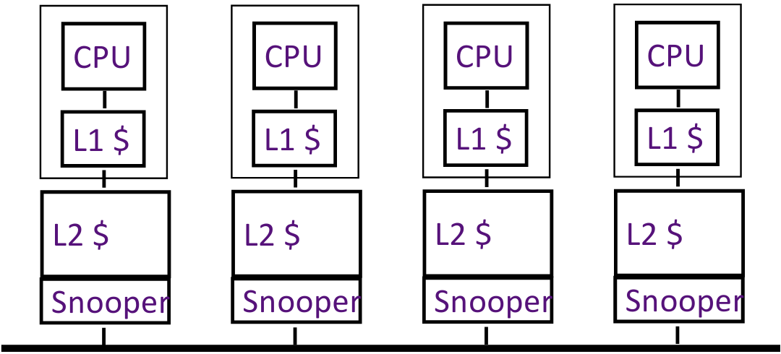
Inclusion Policy and Coherence (2020 Q4 A)
In lecture, it was mentioned that an inclusive L2 cache can act as a filter to reduce the amount of L1 coherence traffic in a snoopy cache-coherence protocol.

Slide 20
Inclusion Policy and Coherence (2020 Q4 A)
Explain how a strictly exclusive L2 cache can also be used to optimize snooping.
Could a non-inclusive, non-exclusive L2 cache (i.e., neither strictly inclusive nor strictly exclusive) be similarly used to optimize snooping?

Slide 21
False Sharing (2019 Q4 D)
Indicate which memory operations experience a hit, true sharing miss, or false sharing miss under an MSI protocol, and explain why. Assume that x1 and x2 reside in the same cache line, and both words have been read by processors P1 and P2 initially.
Time | P1 | P2 | Hit, True Sharing Miss, False Sharing Miss? |  |  | P1 state | P2 state
1 |  | write x2 | True miss: invalidate x2 in P1
2 | read x1
3 |  | read x1
4 | write x2
5 |  | write x1

Slide 22
Directory-based Coherence (2019 Q4)
Consider a multi-core system with a simplified directory protocol based on Handout #6
Cache states: C-nothing, C-shared, C-exclusive, C-pending
Directory states: R(dir), W(id), T_{R}(id_{req}, dir), T_{W}(id_{req}, id)
Protocol messages:
Assume agents can send/receive multiple messages simultaneously
Assume messages take one time step to reach destination
Category | Messages
Cache to Memory Requests | ShReq, ExReq
Memory to Cache Requests | WbReq, InvReq, FlushReq
Cache to Memory Responses | WbResp, InvResp, FlushResp
Memory to Cache Responses | ShResp, ExResp

Slide 23
Directory-based Coherence (2019 Q4 E)
Indicate the series of events that occur to service a load miss from core 0 when core 4 has the line cached in the C-exclusive state.
Time | Agent | Current State | Event / Message Received | Next State | Messages Sent
0 | Core 0 | C-nothing | Load | C-pending | ShReq(0)
Messages
ShReq, ExReq
WbReq, InvReq, FlushReq
WbResp, InvResp, FlushResp
ShResp, ExResp

Slide 24
Directory-based Coherence (2019 Q4 F)
Indicate the series of events that occur to service a store miss from core 0 when cores 0, 4, and 8 have the line cached in the C-shared state.
Time | Agent | Current State | Event / Message Received | Next State | Messages Sent
0 | Core 0 | C-shared | Store | C-pending | ExReq(0)
Messages
ShReq, ExReq
WbReq, InvReq, FlushReq
WbResp, InvResp, FlushResp
ShResp, ExResp

Slide 25
Directory-based Coherence (2020 Q4 C)
Note that the directory only sends an InvReq to a cache if the cache is a current sharer of a given line according to the directory state.
How is it possible for the cache to be in the C-nothing state when the InvReq arrives?
Why is it correct for the cache to ignore the InvReq in this case?

Slide 26
Directory-based Coherence (2020 Q4 C)
Suppose a cache requests exclusive access to a line (ExReq) when the line is clean and shared by other caches.
To reduce the response latency, we consider sending the ExRep message with the data to the requestor in parallel to sending InvReq to the other caches, without waiting for InvReps. Does this optimization work correctly, assuming FIFO delivery?

Slide 27
Memory Consistency and OOO (2018 Q3)
Store Queue
Instruction number | Address | Value
3 | 0x1000 | 0xF00D3ABC
6 | 0x2000 | Unknown
11 | Unknown | Unknown
15 | 0x3000 | 0xDEADBEEF
17 | Unknown | Unknown
DCache
Address | Value
0x1000 | 0xAABBCCDD
0x2000 | 0xBADE2140
0x3000 | 0x1234ABCD
Stores are kept in the store queue until they commit
Loads following cache misses can read the data in the non-blocking data cache if there is no violation of the memory model
The core uses conservative out-of-order load/store execution

Slide 28
Store Queue
Instruction number | Address | Value
3 | 0x1000 | 0xF00D3ABC
6 | 0x2000 | Unknown
11 | Unknown | Unknown
15 | 0x3000 | 0xDEADBEEF
17 | Unknown | Unknown
DCache
Address | Value
0x1000 | 0xAABBCCDD
0x2000 | 0xBADE2140
0x3000 | 0x1234ABCD
Load Queue
Instruction number | Address | Can complete? | Value
1 | 0x2000
5 | 0x3000
7 | 0x1000
8 | 0x4000
9 | 0x2000
16 | 0x3000
18 | 0x3000
Under sequential consistency (SC), assuming the stores make no progress, can each load complete? If so, what value does it read?

Slide 29
Store Queue
Instruction number | Address | Value
3 | 0x1000 | 0xF00D3ABC
6 | 0x2000 | Unknown
11 | Unknown | Unknown
15 | 0x3000 | 0xDEADBEEF
17 | Unknown | Unknown
DCache
Address | Value
0x1000 | 0xAABBCCDD
0x2000 | 0xBADE2140
0x3000 | 0x1234ABCD
Load Queue
Instruction number | Address | Can complete? | Value
1 | 0x2000
5 | 0x3000
7 | 0x1000
8 | 0x4000
9 | 0x2000
16 | 0x3000
18 | 0x3000
Under total store ordering (TSO), assuming the stores make no progress, can each load complete? If so, what value does it read?

Slide 30
Store Queue
Instruction number | Address | Value
3 | 0x1000 | 0xF00D3ABC
6 | 0x2000 | Unknown
11 | Unknown | Unknown
15 | 0x3000 | 0xDEADBEEF
17 | Unknown | Unknown
DCache
Address | Value
0x1000 | 0xAABBCCDD
0x2000 | 0xBADE2140
0x3000 | 0x1234ABCD
Load Queue
Instruction number | Address | Can complete? | Value
1 | 0x2000
5 | 0x3000
7 | 0x1000
8 | 0x4000
9 | 0x2000
16 | 0x3000
18 | 0x3000
Under weak multi-copy-atomic memory model, assuming the stores make no progress, can each load complete? If so, what value does it read?

Slide 31
Store Queue (Thread 1)
Instruction number | Address | Value
3 | 0x1000 | 0xF00D3ABC
6 | 0x2000 | Unknown
11 | Unknown | Unknown
15 | 0x3000 | 0xDEADBEEF
17 | Unknown | Unknown
DCache (Shared)
Address | Value
0x1000 | 0xAABBCCDD
0x2000 | 0xBADE2140
0x3000 | 0x1234ABCD
Load Queue (Thread 2)
Instruction number | Address | Can complete? | Value
1 | 0x2000
5 | 0x3000
7 | 0x1000
8 | 0x4000
9 | 0x2000
16 | 0x3000
18 | 0x3000
Now assume all stores are executed by thread 0, while all loads are executed by thread 1.
Assume the stores make no progress. Under the weak multi-copy-atomic memory model, can each load complete?

Slide 32
Synchronization (2018 Q6)
The semaphore is a shared integer initialized to N. Two functions, “wait” and “signal”, must be implemented. The wait function spins until the integer is >0. It then decrements the integer and finishes. The “signal” function increments the integer. In this way, only N threads can pass through the “wait” function before the “signal” function is called.
void wait(int *sem) { while (*sem <= 0) {} *sem = *sem - 1; } | void signal(int *sem) { *sem = *sem + 1; }

Slide 33
Synchronization (2018 Q6)
Assuming the memory system is sequentially consistent, does this code correctly implement wait and signal? If not, how might this implementation fail to guarantee that only N threads enter the critical section?
void atomic_add(int *dst, int inc);
void wait(int *sem) { while (*sem <= 0) {} atomic_add(sem, -1); } | void signal(int *sem) { atomic_add(sem, 1); }

Slide 34
Synchronization (2018 Q6)
Implement wait and signal using compare-and-swap
int cas(int *dst, int old, int new);
Atomically checks if (*dst == old) and writes new to *dst if they match
Returns 1 on success and 0 on failure
void wait(int *sem) { } | void signal(int *sem) { }

Slide 35
Synchronization (2018 Q6)
Implement wait and signal using LR-SC
int load_reserved(int *src);
Load and return the value from *src and set a reservation.
int store_conditional(int* dst, int new);
Store new to *dst if the reservation is still set. Return 1 on success and 0 on failure.
void wait(int *sem) { } | void signal(int *sem) { }

Slide 36
Afterword
It’s been a pleasure being your GSIs this semester.
Good luck on finals and beyond!

